Slide 1
Connect for Health Pediatric Weight Management Program Overview
Practice Coach & Clinician Champion Training – Part 2
Presenter Name
Presenter department and roles
Date
*Note: Please use this presentation as
a template and feel free to update
with site specific information and
updated references.
Notes:
Suggested Presenter: Expert in childhood obesity or clinician champion

Slide 2
Overview
Connect for Health randomized controlled trial
Dissemination & implementation of Connect for Health
Project goals
Stakeholder engagement
Connect for Health bundle
Family-facing tools
Clinician-facing tools
Clinician & staff training
Program evaluation

Slide 3
Connect for Health Pediatric Weight Management Program
A proven effective, multilevel intervention
Program to improve childhood obesity screening, management, and body mass index (BMI)
Clinician and family-facing tools

Slide 4
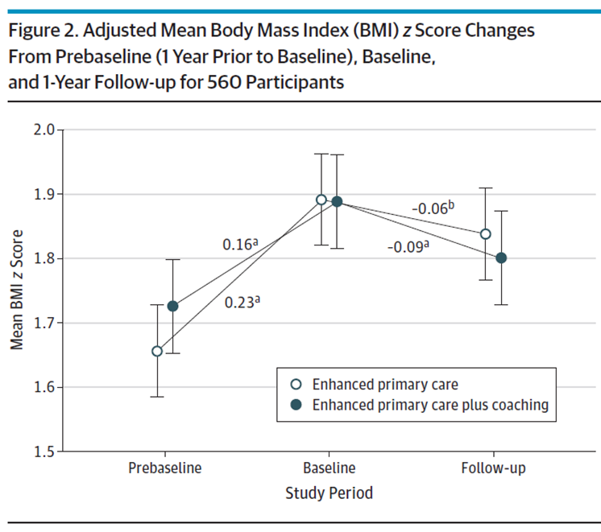
Connect 4 Health
Randomized trial
2-12 year olds + overweight or obesity
6 pediatrics offices in MA
721 children
1 year duration
Intervention Components: Electronic decision support tools; Behavior change materials; Text messaging; Neighborhood resources; Health Coaching
Outcomes: Changes in BMI z-score; child quality of life; behavior change
Taveras et al., 2017, JAMA Peds

Slide 5
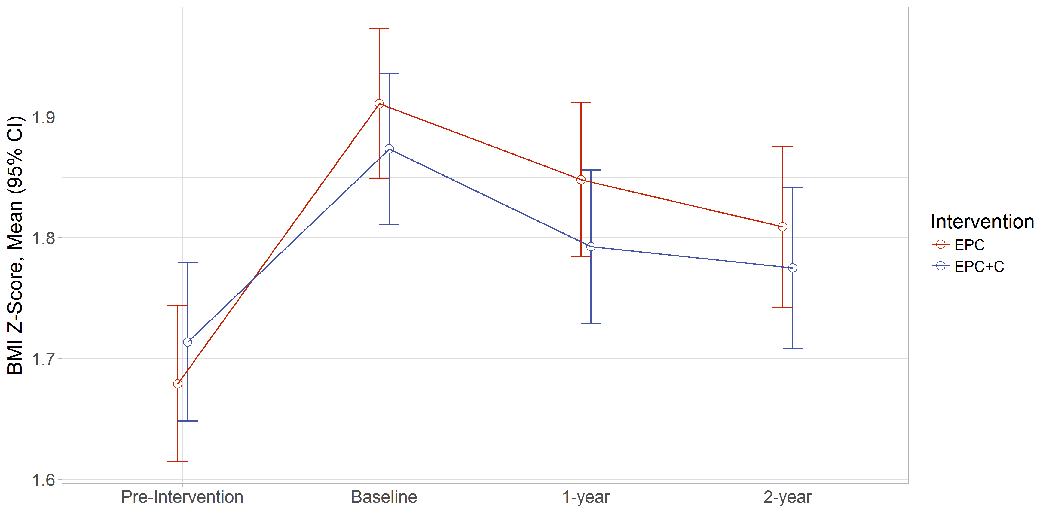
Two-Year Changes in Body Mass Index z Score
Enhanced Primary Care
Enhanced Primary Care + Coaching
Notes:
In January 2018, we examined 2-year BMI z-score outcomes to assess for sustainability of the interventions’ effectiveness. We found that intervention effects on BMI z-score were maintained in both groups

Slide 6
Evaluation of Implementation and effectiveness of the Connect for Health across 4 health systems
Research initiative was funded by the Patient-Centered Outcomes Research Institute (PCORI) and the National Institutes of Health (NIH).
Implemented and evaluated in three different states that served diverse patient populations.
Denver Health in Colorado (9 practices)
Prisma Health in South Carolina (7 practices)
Massachusetts General Hospital – Massachusetts (6 practices)
Boston Medical Center – Massachusetts (1 practice)
Clinician and family-facing tools
For families: Text messaging, educational handouts, community resources
For clinicians: EHR best practice alerts, access to education materials for families, and weight management trainings
Adapted and appropriate for telehealth use
Outcomes of C4H
Changes in BMI, family experience of care, implementation outcomes
Simione et al., 2021, J. Comp. Eff. Res.
Notes:
Reference:
Simione, M., et al. (2021). Implementation of the Connect for Health pediatric weight management program: study protocol and baseline characteristics. Journal of Comparative Effectiveness Research, 10(11), 881–892. https://www.futuremedicine.com/doi/full/10.2217/cer-2021-0076

Slide 7
We have optimized and adapted the Connect for Health at our site
Engagement of stakeholders to understand needs, preferences, and workflow at each site
Alignment of program with quality improvement metrics and priorities for each site
Stakeholders
Families
Clinicians
Medical Staff
Administrators
Feedback
Adaptation

Slide 8
Example of How Connect for Health was Adapted & Optimized
Feedback from clinician interviews
Clinicians wanted resources to address pediatric weight management and preferred tools that were culturally appropriate and enhanced patient care without disrupting workflow
“Some of our BPAs - the ones that are part of the screen so you can see they’re there, but they’re not obtrusive and they allow you to act on them at any time. I think those are helpful potentially.”
“Things that are relevant in a variety of different cultural contexts like Hispanic families or families from Asian or Indian backgrounds. Broadening the examples of foods that I give would also help.”
“This is an area that is very frustrating for me because I feel that we don’t have adequate support for caring for these patients”
*Note: Add examples of how you have customized at your site

Slide 9
Adapting & Optimizing Connect for Health
Based on stakeholder feedback, we have modified…
EHR tools
Patient educational materials
Text messaging campaign
Community-based resources
Clinician training
*Note: Add examples of how you have customized at your site
Notes:
Customize

Slide 10
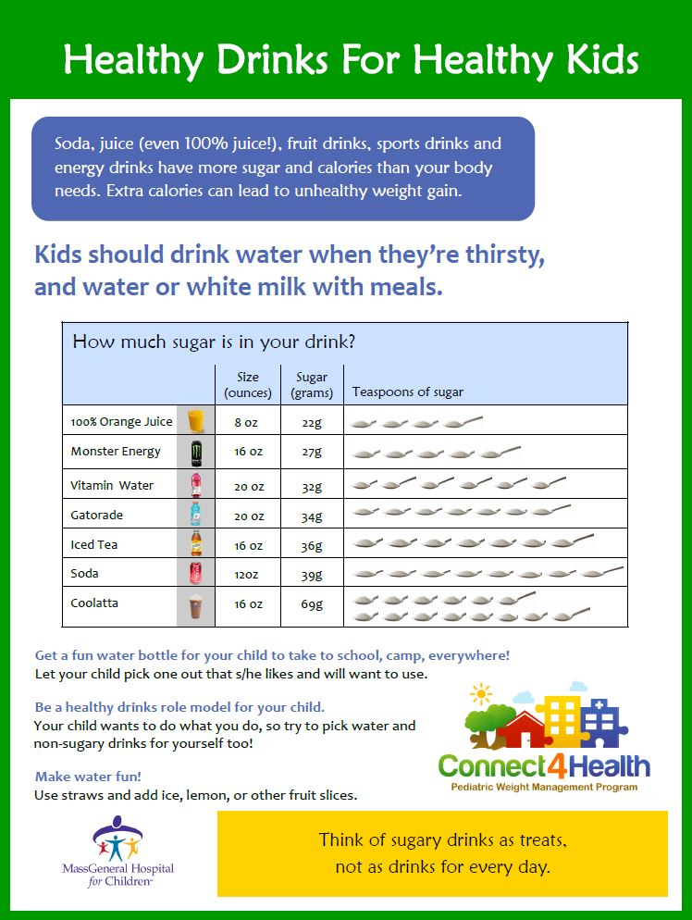
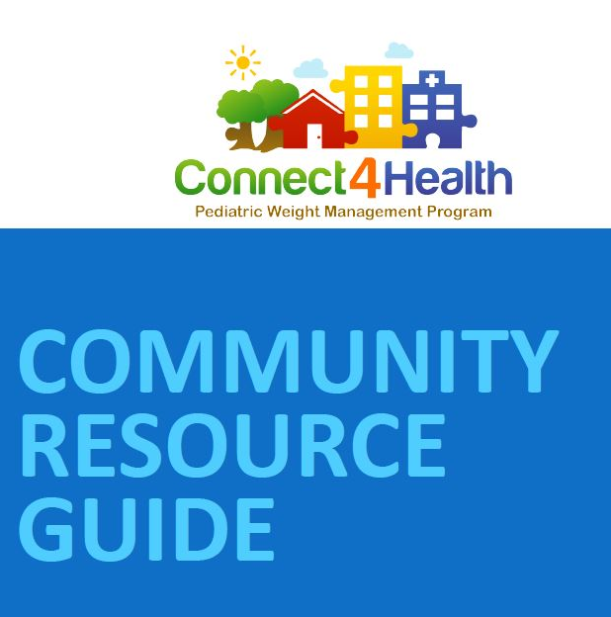
Connect for Health Bundle for families
Parent & child facing tools:
Educational materials to support behavior change self-management;
Social- and community-informed text messages;
Connections to community resources.
Notes:
Change to navigator tab

Slide 11
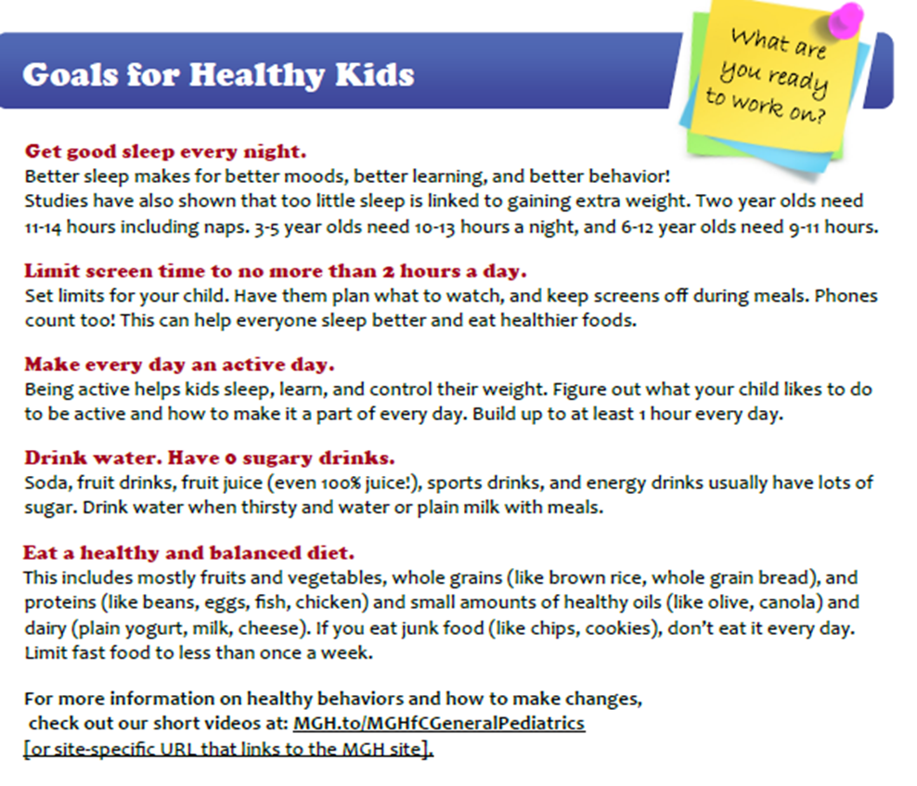
Educational Materials

Slide 12
Text Messaging
1-2 scheduled messages sent per week for one year
Self-monitoring messages to help parents track child’s health-related behaviors
Skills training messages that delivered tips and encouraged families to work towards the targeted goal for each behavior
Messages that connect families to resources
How much sleep do kids need? 2 year-olds need 11-14 hours including naps. 3-5 year-olds need 10-13 hours a night, and 6-12 year-olds need 9-11 hours.
Check out ChopChop Magazine for kids online and get your kids helping in the kitchen. Healthy cooking ideas and lots of fun!
www.chopchopmag

Slide 13
Neighborhood Resource Guide
Insert Resource Name Here
Description
Days and Hours
Address
Website Link
Insert Resource Name Here
Description
Days and Hours
Address
Website Link

Slide 14
Connect for Health Bundle for clinicians
Flagging of children with BMI ≥ 85th/ 95th percentile;
Clinician decision support tools to guide (1) screening; (2) management; and (3) follow-up;
Clinician training and support.

Slide 15
Flagging System for Elevated BMI
[*Note: Please insert site specific screenshot of flagging system such as a “Best Practice Alert (BPA)” that fires based on height and weight, and the child's BMI]
Notes:
SITES – Please customize with your own Epic screenshots
Can also talk about other ways children will be flagged based on feedback

Slide 16
Clinical Decision Support Tools
Diagnoses
Lab orders
Structured note template
Patient education materials
Text message enrollment
Referrals
Follow-up
After visit summary
*Note: Customize with site specific list of content in the clinical decision support tools
[Insert site specific screenshot of clinical decision support tools such as “Smart Set” that displays the following list]
Notes:
SITES – Please customize with your own Epic screenshots

Slide 17
Clinician Training and Support
EHR screening and clinical decision support tools
Clinician champions and practice coaches for “at the elbow support”
In-person trainings and check-ins
Tutorials, manuals, EHR Tip Sheets
Virtual learning community
Website http://c4hprogram.com/
Strategies to support integration into practice
Strategies to increase knowledge
Notes:
Clinicians—watch language
Have goals of VLC for myself

Slide 18
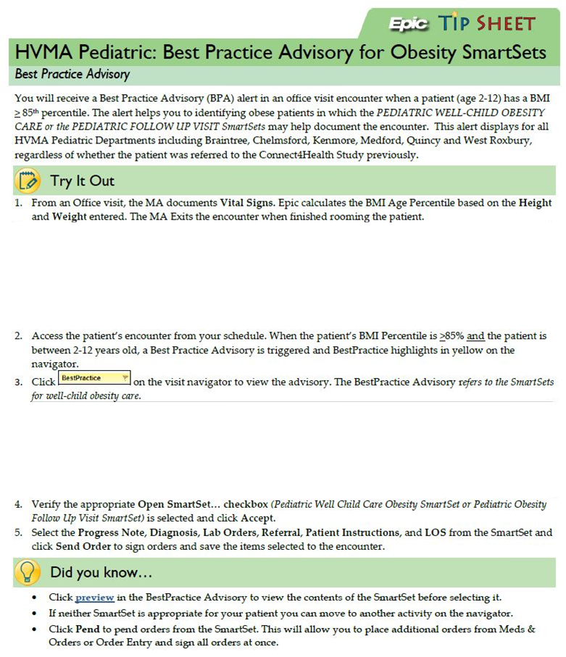
EHR Tip Sheet
*Note: Please insert site specific Electronic Health Record (EHR) screenshot of tip sheet that highlights on how to use Connect for Health flagging system and clinical decision support tools and their location in your EHR system
[Please insert site specific screenshot of vitals that capture height and weight, and the child's BMI]
[Please insert site specific screenshot of flagging system such as a “Best Practice Alert (BPA)” that shows clinical decision tools options]
Notes:
SITES – Please customize with your own tip sheet
Electronic health record (EHR)

Slide 19
Program Evaluation: Implementation Outcomes
*Healthcare Effectiveness Data and Information Set
*Note: Customize based on how site will evaluate program
Notes:
*Note: Customize based on how site will evaluate program

Slide 20
Program Evaluation: Effectiveness Outcomes
Outcome | Source
Parent’s experiences with care | Parent surveys using the Patient Assessment of Chronic Illness Care
Changes in child BMI | BMI from EHR
*Note: Customize based on how site will evaluate program
Notes:
*Note: Customize based on how site will evaluate program

Slide 21
Resources
Taveras EM, Marshall R, Sharifi M, et al. Connect for Health: Design of a clinical-community childhood obesity intervention testing best practices of positive outliers. Contemp Clin Trials. 2015;45(Pt B):287–295.
https://www.ncbi.nlm.nih.gov/pmc/articles/PMC4753774/
Taveras EM, Marshall R, Sharifi M, et al. Comparative Effectiveness of Clinical-Community Childhood Obesity Interventions: A Randomized Clinical Trial. JAMA Pediatr. Published online August 01, 2017171(8):e171325.
https://www.ncbi.nlm.nih.gov/pmc/articles/PMC6075674/
Price S, Ferisin S, Sharifi M, et al. Development and Implementation of an Interactive Text Messaging Campaign to Support Behavior Change in a Childhood Obesity Randomized Controlled Trial. Journal of Health Communication, 20:7, 843-850. https://www.ncbi.nlm.nih.gov/pubmed/25996181
Program website: http://c4hprogram.com
Simione, M., Farrar-Muir, H., Mini, F. N., et al. Implementation of the Connect for Health pediatric weight management program: study protocol and baseline characteristics. Journal of Comparative Effectiveness Research, 10(11), 881–892. https://www.futuremedicine.com/doi/full/10.2217/cer-2021-0076
Simione, M., Frost, H.M., Cournoyer, R. et al. Engaging stakeholders in the adaptation of the Connect for Health pediatric weight management program for national implementation. Implement Sci Commun 1, 55 (2020). https://link.springer.com/article/10.1186/s43058-020-00047-z

