Slide 1
Connect for Health
Pediatric Weight Management Program
Practice Coach & Clinician Champion Training – Part 1
Presenter Name
Presenter department and roles
Date
*Note: Please use this presentation as
a template and feel free to update
with site specific information and
updated references.
Notes:
Suggested Presenter: Expert in childhood obesity or clinician champion

Slide 2
Main Points for Discussion
Importance of childhood obesity
  Background & epidemiology
  Definitions and nomenclature
  Consequences/co-morbid conditions
Management
  Screening and identification
  Treatment approaches
    U.S. Preventive Services Task Force Recommendations
    American Academy of Pediatrics
    Counseling strategies/ Talking to caregivers about weight management
  Behavioral targets
  Weight sensitivity/bias
Case examples
Resources

Slide 3
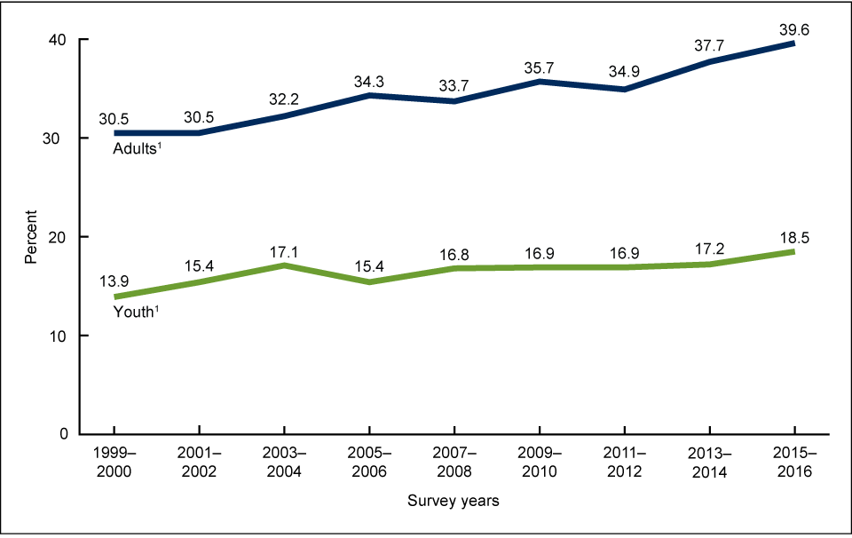
Trends in obesity prevalence among adults and youth:1999–2016
Obesity Prevalence
*Note: Please feel free to update references
Hales…Ogden et al. JAMA. 2018
Ogden CL, et al. NCHS Data Brief No. 288, October 2017.
Notes:
*Note: feel free to update references.

Slide 4
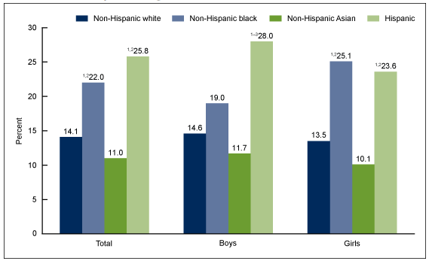
Obesity Prevalence
Prevalence of obesity among youth aged 2–19 years, by sex and race and Hispanic origin: United States, 2015–2016
*Note: Please feel free to update references
Hales…Ogden et al. JAMA. 2018
Ogden CL, et al. NCHS Data Brief No. 288, October 2017.
Notes:
*Note: feel free to update references.

Slide 5
Weighted Prevalence of Obesity in US Children Aged 2 to 19 Years by Race Origin, 2015-2016
ALL CHILDREN
18.5 %
NON-HISPANIC WHITE
14.1 %
Racial and ethnic disparities in obesity are already present by the age of two and persist into adulthood
NON-HISPANIC BLACK
22.0 %
NON-HISPANIC ASIAN
11.0 %
HISPANIC
25.8 %
Hales…Ogden et al. JAMA. 2018
Ogden CL, et al. NCHS Data Brief No. 288, October 2017.
Notes:
*Note: feel free to update references.

Slide 6
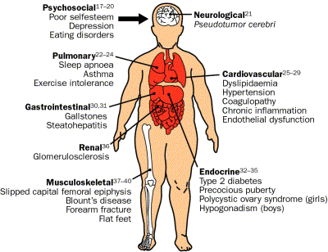
Why is Childhood Obesity Important?
Childhood obesity is associated with both short- and long-term consequences including:
  Fatty Liver Disease
  Diabetes
  Heart Disease
  5 times more likely to have obesity as adults → Increased cancer risk (oesophageal, gastric, colorectal, pancreatic, liver)
A watershed moment in tackling childhood obesity
(May 2019). The Lancet, p.325.

Slide 7
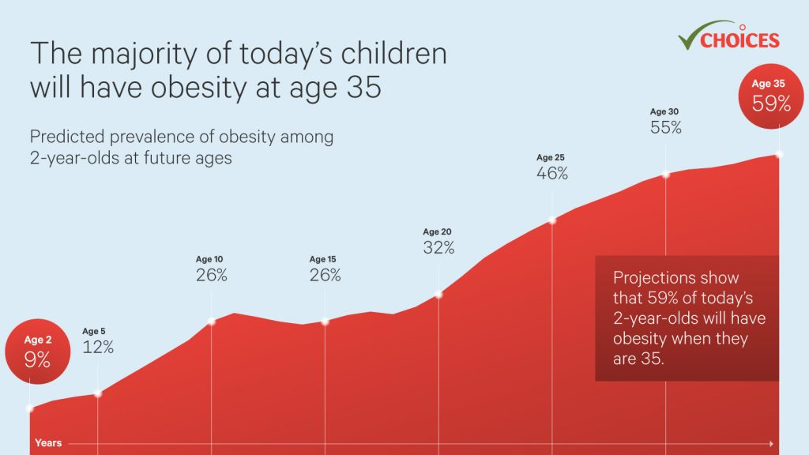

Slide 8
Summary of Evidence & Recent Trends
Childhood obesity is highly prevalent, spares no age group, and is of consequence;
Obesity disproportionately affects racial/ethnic minorities;
Among non-Hispanic white children, obesity prevalence increases as household income and education of head of household decreases – inconsistent association among non-white children;
Progress has been made in obesity reductions among low-income preschool age children;
Not yet closing the gap in disparities with evidence to suggest that the highest risk children have not benefited equally from national obesity prevention efforts.

Slide 9
Selected Determinants of Childhood Obesity
Early Life
Maternal Obesity, excess gestational weight gain (Oken, Taveras et al. 2006) and GDM
Maternal smoking during pregnancy (Oken, Taveras, et al. 2006)
Rapid infant weight gain (Taveras et al. 2009)
Breastfeeding (Taveras et al. 2005)
Responsiveness to infant hunger and satiety cues (Hodges and Fisher, 2008)
Parental feeding practices, eating in the absence of hunger (Taveras, 2006, Fisher and Birch, 1998 & 2009)
Sleep duration & quality (Taveras et al. 2008)
Later Childhood
Portion sizes (Fisher et al. 2008)
Fast food intake (Taveras et al. 2006)
Sugar-sweetened beverages
Physical activity
Sleep duration and quality (Taveras et al. 2008)
Television viewing (Taveras et al. 2007) & TV sets in bedrooms
Food & marketing environments
Socio-cultural, recreation, & transport environments

Slide 10
Role of Pediatric Primary Care
The primary care setting offers unique opportunities to intervene for children at risk for obesity and its complications.
Regular visits during childhood allow both detection of elevated BMI levels and offer opportunities for prevention and treatment.
The continuity of the pediatrician/family relationship, embodied in the concept of the “medical home,” has been associated with increased parental satisfaction, particularly on measures of patient-doctor communication.
Notes:
10

Slide 11
Primary Care
Guidelines:
Screen for elevated body mass index
Use evidence based guidelines for management
Laboratory evaluation as needed
Provide counseling (nutrition/activity/sleep/social-emotional wellness)
Refer for treatment
Make a plan for follow-up

Slide 12
Sample Patient
KB is a 3.9 year old boy referred for weight management; rapid weight gain since 12 months of age; BMI = 35 kg/m²
  Significant nutritional/feeding issues
    Unhealthy foods in house and processed/diet foods
    Mother restricts foods to help with weight – “I say no all the time.” Father is supportive but disagrees with restricting.
    KB “starts crying if I don’t let him have snack at night”
    Poor meal/snack planning and timing
    High anxiety, fighting, push back from child

Slide 13
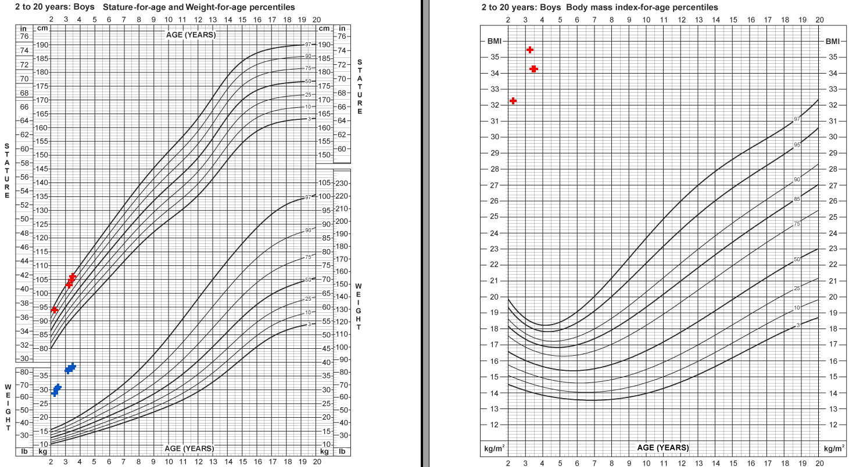

Slide 14
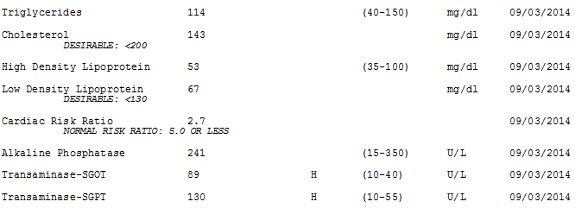
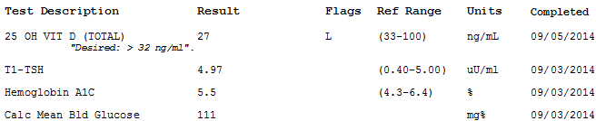
Laboratory Analyses

Slide 15
Sample Patient
Previously followed in primary care & has had subspecialty referrals to genetics (no evidence of syndromic obesity), nutrition, and orthopedics;
Diagnosed as having severe obesity, obstructive sleep apnea, infantile bilateral Blount’s Disease, elevated transaminases.

Slide 16
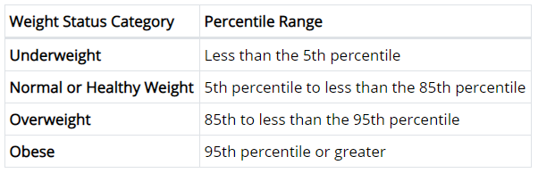
Definitions

Slide 17
Definition & Nomenclature
Severe obesity in children ≥ 2 years of age and in adolescents defined as:
  BMI greater than 120% of the 95th percentile for age and sex or a BMI of 35 or greater (American Heart Association), whichever is lower based on age and sex.
  used in place of the 99th percentile because it has been shown to demonstrate more stability in estimation.
  Sometimes called “Class 2 obesity” to align with adult category of obesity severity.

Slide 19
Evaluation & Co-Morbid Conditions
Although severe pediatric obesity has been defined in a variety of ways across studies, available data suggest that children in this category have a worse cardiovascular risk factor profile than their less obese counterparts.
Children (age 12) with a BMI >99% followed into adulthood (age 27).
  100% BMI >30
  90% with BMI >35
  65% with BMI >40
Freedman DS, Mei Z, Srinivasan SR, et al. J Pediatr. 2007;150(1):12-17.

Slide 20
Comorbidities of Obesity
Pseudotumor cerebri
Slipped capital femoral epiphysis
Blount’s disease
Sleep apnea
Asthma
Nonalcoholic hepatosteatosis
Cholelithiasis
Insulin resistance (metabolic syndrome)
Type II diabetes
Polycystic ovary syndrome
Hypertension
Hyperlipidemia
Poor quality of life
Disordered eating
Depression

Slide 21
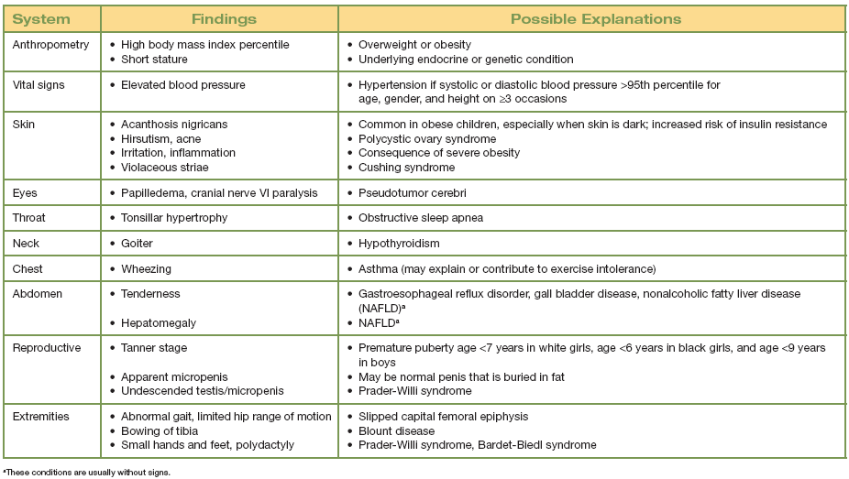
Physical Examination
Obesity Assessment: Physical Examination Findings and Possible Etiologies

Slide 22
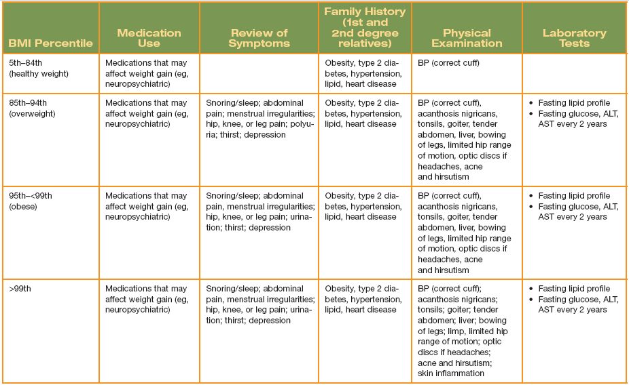
Medical Screening by BMI Category

Slide 23
Treatment Approaches
Lifestyle modification/Behavioral Therapy
  Family training
Medications
Surgery

Slide 24
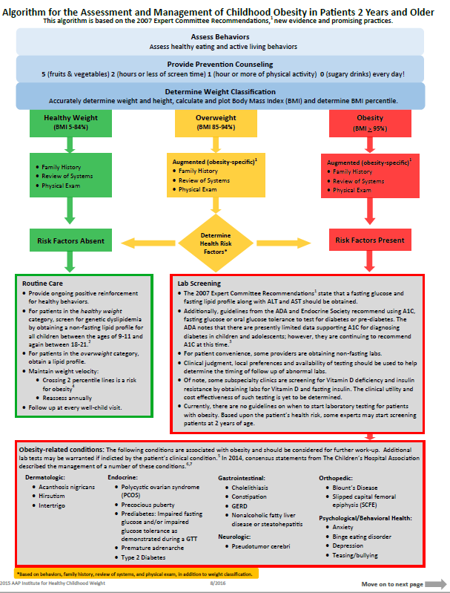

AAP Obesity Management Algorithm

Slide 25
AAP Obesity Management Algorithm

Slide 26
AAP Obesity Management Algorithm

Slide 27
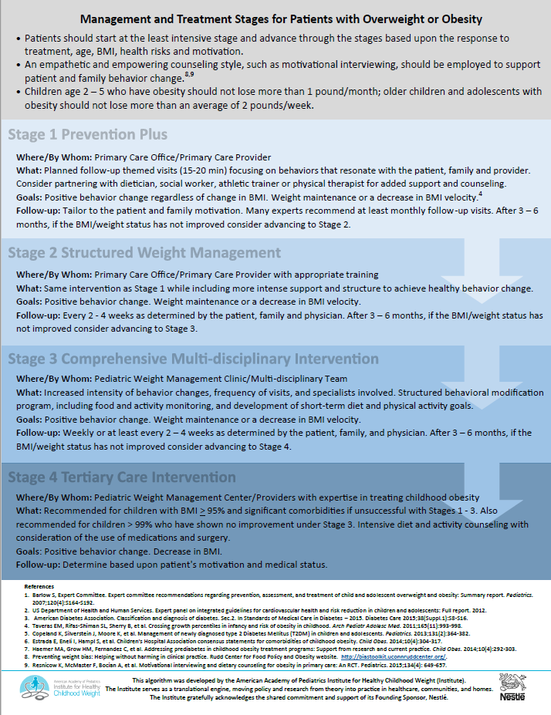
AAP Obesity Management Algorithm

Slide 28
AAP Obesity Management Algorithm

Slide 29
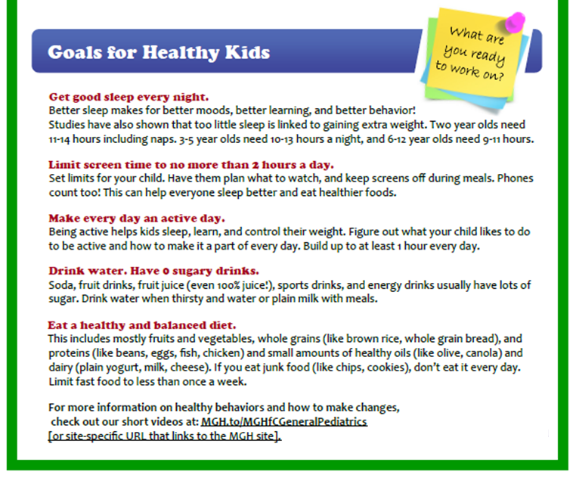
Behavioral Targets

Slide 30
Stoplight Diet Program
Clinically supervised, multi-component weight mgmt. program
Whole family involvement
Foods linked to traffic light colors
    High-calorie foods ="red“
    Moderate-calorie foods ="yellow"
    Low calorie foods, vegetables =“green“
Weight checks, food logs, group support
The key to the traffic light system, is its lack of ambiguity and simplicity. Every food has a color and you can count the foods you eat and set goals based on the colors... We know it is much more difficult to count calories or balance types of nutrients, such as carbohydrates, protein and fat. --Tom Robinson, MD

Slide 31
US Preventive Services Task Force
In 2010 the USPSTF updated their evidence-based recommendations on screening and management of obesity in children. Their findings were reaffirmed with a new release in November 2016.
Recommendations:
  Clinicians screen children ≥ 6 years of age for obesity using BMI, and
  Offer comprehensive, intensive behavioral interventions to promote improvement in weight status. Evidence suggests behavioral interventions with 26 or more hours of intervention contact are likely to help reduce excess weight in children and adolescents.
Behavioral interventions with at least 26 hours of contact consistently demonstrated small average reductions in excess weight
No evidence of these programs causing harm.
Relative reductions in BMI z-score of 0.20 or more were typical which were linked to cardiometabolic improvements
Hours of contact was the only study or intervention characteristic that was clearly related to effect size, with larger effects seen in trials with more contact hours.

Slide 32
Comprehensive Multidisciplinary Protocol
Multidisciplinary obesity care team
  Physician, nurse, dietician, exercise trainer, social worker, psychologist
Activities within this category should include:
  Structured behavioral modification program, including food and activity monitoring and development of short-term diet and physical activity goals
Behavior modification
  Involvement and training of primary caregivers/families in children under age 12 years

Slide 33
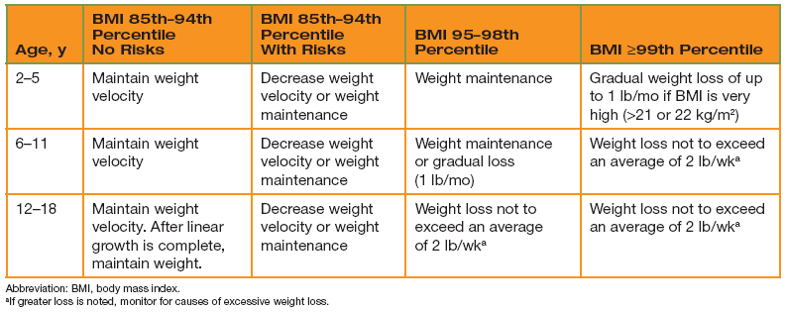
Weight Targets
American Academy of Pediatrics. Pediatric Obesity Clinical Decision Support Chart. Elk Grove Village, IL: American Academy of Pediatrics; 2008.

Slide 34
Tertiary Care Protocol
Referral to pediatric tertiary weight management center with access to a multidisciplinary team with expertise in childhood obesity and which operates under a designed protocol;
Continued diet and activity counseling and the consideration of such additions as meal replacement, very-low-calorie diet, medication, and surgery.

Slide 35
Pharmacotherapy
Orlistat is the only medication approved by the FDA for weight management in children and only for those ≥ 12 years
  Lipase inhibitor, blocks the absorption of fat, is administered orally 3 times per day;
  Shown to have modest weight loss efficacy in obese children and adolescents;
  Good safety profile but tolerability issues such as oily evacuation, fecal urgency, and abdominal pain are relatively common and limit widespread use

Slide 36
Surgery
Bariatric surgery has become a more broadly accepted approach to treatment of highly selected adolescents who are suffering from the health and psychosocial effects of severe obesity.
Most common procedures used for adolescents with severe obesity include:
  Roux en Y gastric bypass
  Adjustable gastric banding
  Sleeve gastrectomy

Slide 37
Weight Management Counseling
MI is a client-centered communication style used extensively to modify health behavior and is a recommended counseling style for pediatric obesity.
RCT findings:
Overweight children whose parents received MI counseling from their primary care providers supplemented by RD counseling, showed a significant reduction in BMI percentile over 2 years compared with children whose parents received routine PCP care.
Resnicow et al., Motivational Interviewing and Dietary Counseling for Obesity
in Primary Care: An RCT. Pediatrics. 2015.

Slide 38
Weight Management Counseling
Motivational Interviewing style
  Interactive and supportive counseling
  Patient-centered/Collaborative
  Empathic
  Goal-oriented

Slide 39
Key Motivational Interviewing Strategies
Open-ended questions
  Require more thoughtful and exploratory answer
Reflective listening
  Non-judgemental; Uses patients own words to guide towards change
Affirmations
  Enhances rapport; builds self-esteem
Asking permission; sharing information
  Shows respect
Summarizing

Slide 40
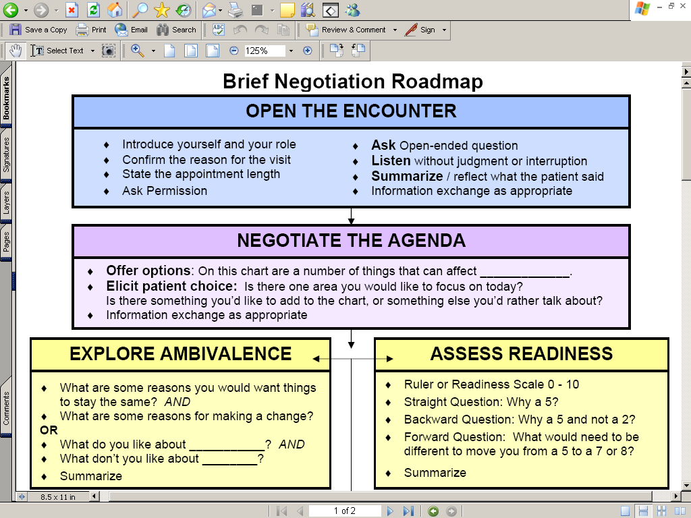
http://www.kphealtheducation.org/

Slide 41
Brief Focused Encounter
Engage the parent
  Can we take a few minutes to talk about what you’ve told me about Hannah’s screen time?
Share information
  Children who have more than 2 hours a day of screen time are less likely to be physically active and tend to gain weight more rapidly.
Make a key advice statement
  Hannah’s screen time should be limited to less than 2 hours a day.
Provide supportive materials and arrange for follow-up.
  Here are some ways you can help her cut back on screen time.
  Let’s set up a time to talk again next month to check in on how things are going.

Slide 42
Outcomes that matter to many parents
Silent co-morbidities
  Weight bias and stigmatization,
  Relational victimization; Bullying; Social marginalization
  Poor self-esteem
Health-related quality of life
Activity limitations and exercise intolerance
Physical appearance - gynecomastia (boys), early puberty (girls), Clothing size
Confidence and self-efficacy
Weight and BMI

Slide 43
Strategies to support parents
Empower parents to be the “policy-makers” in their own homes
  Promote parent’s self-efficacy in being the leaders of their homes;
    They create (and enforce) the “house” rules on screen time, bedtime, homework, physical activity participation, snacking, caffeinated beverages, and eating in front of TVs.
De-emphasize weight/BMI goal and focus instead on outcomes of interest to parents and children, i.e:
  Child doing well in school → decrease screen time and read more
  Good behavior, attention → get more sleep, earlier to bed
  Organized, functional household → Keep routines, schedules, plan ahead
  Fit into size 12 clothing to be able to avoid plus-size store → cut out sugary drinks

Slide 44
Weight Bias
Definition
Negative attitudes toward individuals with obesity
Stereotypes leading to:
  Stigma
  Rejection
  Prejudice
  Discrimination
Verbal, physical, relational, online
Subtle and overt
Replacing bias with evidence
Building understanding of obesity; complex, chronic disease
Delivering evidence-based care
Expanding and improving upon options

Slide 45

Weight Stigma
Weight Stigma
Patients with obesity feel stigmatized most often by their family and then 2nd by healthcare professionals
Patient perception of stigma can cause stress
Stress can lead to poor communication with healthcare professionals, avoidance of health care and negative health outcomes
Shaming patients leads to less successful weight management

Slide 46
Weight Sensitivity
Use person-first language
  Shift the conversation away from “being” overweight or obese
  “Child with obesity or with overweight, child with excess weight or unhealthy BMI”
“Unhealthy weight,” “too much weight for his/her health,” and its Spanish equivalent, “demasiado peso para su salud,” were the most desirable and motivating, and the least offensive terms.
  Commonly used clinical terms “overweight”/“sobrepeso” and “high BMI [body mass index]”/“índice de masa corporal alta” were not as desirable or as motivating. (Knierim, Hambridge et al. 2018)
Children are still growing so even gaining weight at a less rapid pace is a success
Focus on healthy behavior change instead of weight

Slide 47
Resources
Motivational Interviewing
  Video Clips: https://www.massgeneral.org/children/research/star/clinician-tools.aspx
  Online training:
    https://go.kognito.com/changetalk
    https://kphealtheducation.org/
  RCT article: Resnicow et al., Motivational Interviewing and Dietary Counseling for Obesity in Primary Care: An RCT. Pediatrics. 2015.
AAP Obesity Management Resources :
  Algorithm of care: https://ihcw.aap.org/Documents/Assessment%20%20and%20Management%20of%20Childhood%20Obesity%20Algorithm_FINAL.pdf
  AAP module (MOC Part II) – Obesity Prevention in Primary Care Self-Assessment (20 CME hours): http://ohioaap.org/MOCPartII/ObesityMOC

Slide 48
Resources
Obesity prevalence statistics:
  Hales CM, Carroll MD, Fryar CD, Ogden CL. Prevalence of obesity among adults and youth: United States, 2015–2016. NCHS data brief, no 288. Hyattsville, MD: National Center for Health Statistics. 2017
Stoplight Diet Review/Evidence:
  https://www.andeal.org/topic.cfm?cat=1429&evidence_summary_id=250033
  http://medicine.buffalo.edu/pediatrics/research_and_facilities/impact.host.html/content/shared/smbs/research_highlights/traffic-light-diet.detail.html
NICHQ Next Steps Guide:
  https://www.nichq.org/resource/next-steps-practitioners-guide-themed-follow-visits-their-patients-achieve-healthy-weight
USPSTF Evidence Summary: Obesity in Children and Adolescents
  https://www.uspreventiveservicestaskforce.org/Page/Document/evidence-summary/obesity-in-children-and-adolescents-screening1

Slide 49
[SITE LOGO GOES HERE]
Contact information:
[insert presenter email here]

