Slide 1
Connect for Health
Pediatric Leadership Meeting
Presenter Name
Date
*Note: Please use this presentation as a template and feel free to update with site specific information and updated references.
Notes:
Presenter Name: Expert in obesity

Slide 2
Agenda
Implementation team & partners
Connect for Health program overview
Original randomized controlled trial
Implementation of Connect for Health pediatric weight management
Your role in the Connect for Health program
Program timeline
Notes:
Implementation or launching team & partners: this can be whoever at you site is helping set this program up at you site

Slide 3
Staff
Insert Image Here
Name
Insert Image Here
Name
Insert Image Here
Name
Insert Image Here
Name
Notes:
Staff can be the implementation staff or team involved in launching the program at you site

Slide 4
Partners & Sites
[Insert any collaborations here]

Slide 5
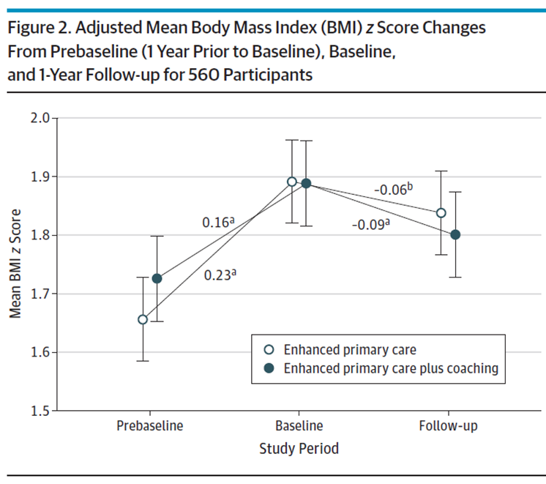
Connect 4 Health
Randomized trial
2-12 year olds with overweight or obesity
6 pediatric offices in MA
721 children
1 year
Intervention Components: Electronic decision support; Behavior change materials; Text messaging; Neighborhood resources; Health Coaching
Outcomes: Changes in BMI z-score; child quality of life; behavior change

Slide 6
Evaluation of Implementation and effectiveness of the Connect for Health across 4 health systems
Research initiative was funded by the Patient-Centered Outcomes Research Institute (PCORI) and the National Institutes of Health (NIH).
Implemented and evaluated in three different states that served diverse patient populations.
Denver Health in Colorado (9 practices)
Prisma Health in South Carolina (7 practices)
Massachusetts General Hospital – Massachusetts (6 practices)
Boston Medical Center – Massachusetts (1 practice)
Clinician and family-facing tools
For families: Text messaging, educational handouts, community resources
For clinicians: EHR best practice alerts, access to education materials for families, and weight management trainings
Adapted and appropriate for telehealth use
Outcomes of C4H
Changes in BMI, family experience of care, implementation outcomes
Simione et al., 2021, J. Comp. Eff. Res.
Notes:
Reference:
Simione, M., et al. (2021). Implementation of the Connect for Health pediatric weight management program: study protocol and baseline characteristics. Journal of Comparative Effectiveness Research, 10(11), 881–892. https://www.futuremedicine.com/doi/full/10.2217/cer-2021-0076

Slide 7
Resources for Pediatric Weight Management
*Note: Customizable
EHR decision support tools
Patient education materials
Patient text messaging campaign
Clinician champions to help facilitate workflow adaptations in the practices
1-on-1 technical support from Practice Coach
Virtual learning community

Slide 8
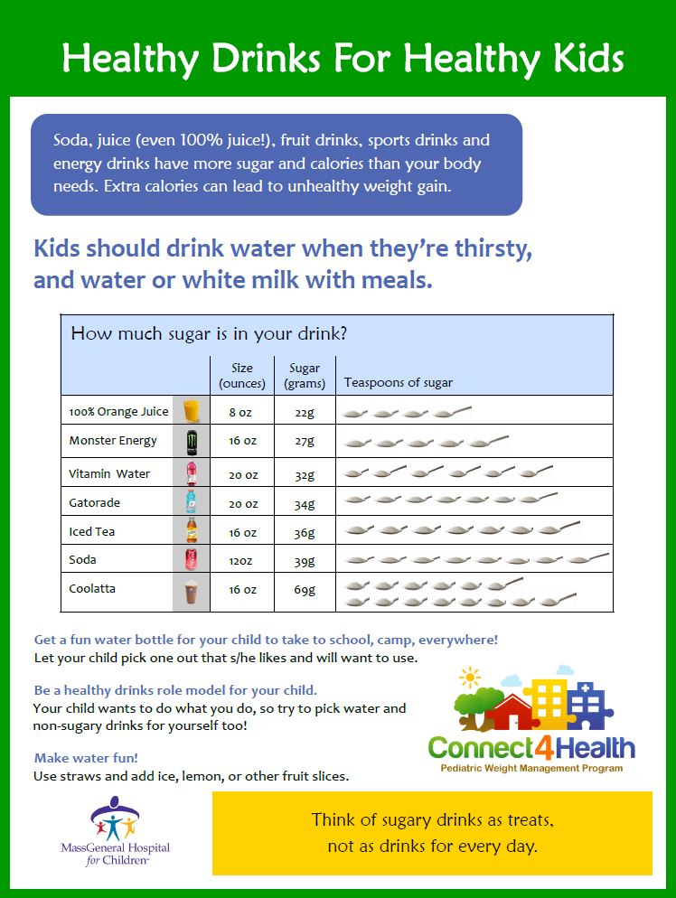
Connect for Health Bundle
EHR tools for providers:
Tools to facilitate capture of [site’s name] Quality Metrics
Flag for children with a BMI ≥ 95th %ile
Structured notes combining well-child care & obesity templates to support screening and initial management
Structured notes to guide follow up visits
Structured notes will include:
HEDIS codes & diagnoses
Recommended labs
Site-specific referrals
Text message enrollment
After visit summary education materials
Parent & child facing tools:
Educational materials to support behavior change self-management;
Text messages;
Connection to community resources

Slide 9
Virtual learning community
Topics include:
Program Overview
Understanding Weight Stigma
Binge Eating & Mindful Eating
Nutrition for Families
Screen Time, Sleep, & Physical Activity
Social & Emotional Wellness
Motivational Interviewing
Follow-Up Weight Management Visits

Slide 10
Program Timeline
*Note: This is an example program timeline, we invite you to edit and update as needed.
 | 2019 |  |  |  | 2020 |  |  |  | 2021
 | Jan- Mar | Apr- Jun | Jul- Sep | Oct- Dec | Jan- Mar | Apr- Jun | Jul- Sep | Oct- Dec | Jan- Mar | Apr- Jun | Jul- Oct
Provider interviews
EHR development
Practice trainings
Implementation in pediatric sites
Collect feedback surveys (optional)

Slide 11
[SITE LOGO GOES HERE]
Contact information:
[INSERT PRESENTER CONTACT INFORMATION HERE]

