Slide 1
Connect for Health Program Family Advisory Board Community Feedback
Presenter Name
Date
*Note: Please use this presentation as a template and feel free to update with site specific information and updated references.
[SITE LOGO GOES HERE]
Notes:
Suggested Presenter: Clinician champion, leadership

Slide 2
Agenda
Program overview
Parent Experience
We would like YOUR feedback
Communication/resources
Office visits
Text messaging program

Slide 3
Overall Goals
Connect for Health is an evidence-based pediatric weight management program based on a randomized trial
Implement the Connect for Health Program across [add name of health system]

Slide 4
Original Connect 4 Health
Randomized trial
2-12 year olds + overweight or obesity
6 pediatrics offices in MA
721 children
1 year duration
Intervention Components: Electronic decision support tools; Behavior change materials; Text messaging; Neighborhood resources; Health Coaching
Outcomes: Changes in weight; child quality of life; behavior change

Slide 5
Connect for Health Bundle
Electronic health record tools for clinicians:
Flagging of children with BMI ≥ 95th percentile;
Structured notes combining well child care & obesity templates to support screening and initial management;
Structured notes to guide follow up visits and referrals;
Clinician training.

Slide 6
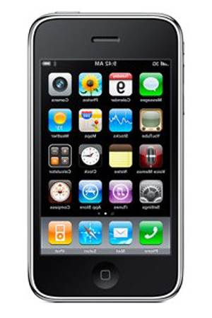
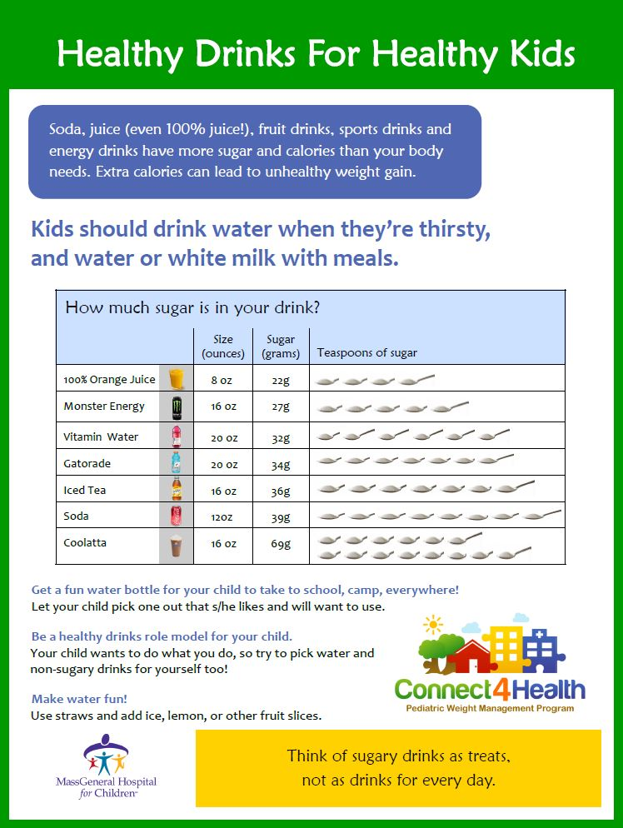
Connect for Health Bundle
Parent & child facing tools (English, Spanish, & Haitian Creole):
Educational materials to support behavior change self-management;
Text messages;
Connections to resources.

Slide 7
First Steps
Engage parents and pediatric doctors to adapt the Connect for Health program to provide the best care for their patients
Adapt and optimize the Connect for Health for [add name of health system] program using the feedback we received from parents and doctors.

Slide 8
Feedback: Health Communication
What are the best ways to get information to parents about making healthy behavior changes?
Text messages
Text message Apps
Email
MyChart
Do you use MyChart for yourself and/or your child?
Website
Social media
Printed handouts in the doctor’s office
Printed handouts mailed to your house
Others?
*Note: Please update slide to reflect methods your site uses to communicate with their patients
Notes:
*Note: Please update slide to reflect methods your site uses to communicate with their patients
EX: MyChart can be changed to per site to reflect patient portal used there

Slide 9
Feedback: Resources
What resources have been most helpful in reducing your stress?
Any other resources for healthy living?

Slide 10
Feedback: Office Visit
If your child had an unhealthy weight, would you like your child’s doctor to…
Ask you/your child about | Discuss | Take action
- Your child’s eating and exercise habits | - The benefits of your child achieving a healthy weight | - Set specific goals to improve your child’s eating or exercise habits
- What motivates your child to achieve a healthier weight | - How you can support your child to achieve a healthier weight | - Refer your child to a specific clinic or community program
- What makes it challenging for your child to achieve a healthier weight |  | - Contact you after your visit to see how things are going

Slide 11
Feedback: Office Visit
If your child had an unhealthy weight, would you like your child’s doctor to…
Ask you/your child about | Discuss | Take action
- Your child’s eating and exercise habits | - The benefits of your child achieving a healthy weight | - Set specific goals to improve your child’s eating or exercise habits
- What motivates your child to achieve a healthier weight | - How you can support your child to achieve a healthier weight | - Refer your child to a specific clinic or community program
- What makes it challenging for your child to achieve a healthier weight |  | - Contact you after your visit to see how things are going

Slide 12
Feedback: Office Visit
If your child had an unhealthy weight, would you like your child’s doctor to…
Ask you/your child about | Discuss | Take action
- Your child’s eating and exercise habits | - The benefits of your child achieving a healthy weight | - Set specific goals to improve your child’s eating or exercise habits
- What motivates your child to achieve a healthier weight | - How you can support your child to achieve a healthier weight | - Refer your child to a specific clinic or community program
- What makes it challenging for your child to achieve a healthier weight |  | - Contact you after your visit to see how things are going

Slide 13
Connect for Health Text Messages
2 messages per week to support behavior change for weight management
Education & skills training messages that deliver tips and encourage families to work towards the targeted goal for each behavior.
Turn off the TV & computers during meals to focus on the food and people around you. If that’s a big change, start with 1 meal a day as a family meal.
Resource messages to connect families to services that support behavior change
EX: Kids are more likely to eat foods they help make. With your child, go online to http://www.chopchopmag.org/recipes and find something new to try together!

Slide 14
Feedback: Text Messaging Program
Is it important to you if the text messages come from your doctor or from the program directly?
How would you want to sign-up for text messages?
What other text or direct messaging apps do you use?
Why do you use these apps? What do you like about them?

Slide 15
[SITE LOGO GOES HERE]
Contact information:
[INSERT CONTACT INFORMATION HERE]

