Slide 1
Connect for Health: Pediatric Weight Management Program EHR and IT Meeting
Presenter Name
Date
*Note: This slide deck is an example, we invite you to edit and update as needed.
[SITE LOGO GOES HERE]
Notes:
Suggested Presenter = Clinician champions, leadership

Slide 2
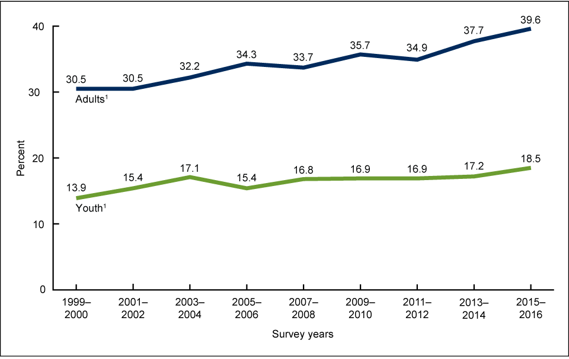
Trends in obesity prevalence among adults and youth: 1999–2016
Obesity Prevalence
*Note: Please feel free to update references.
Hales…Ogden et al. JAMA. 2018
Ogden CL, et al. NCHS Data Brief No. 288, October 2017.
Notes:
*Note: Please feel free to update references.

Slide 3
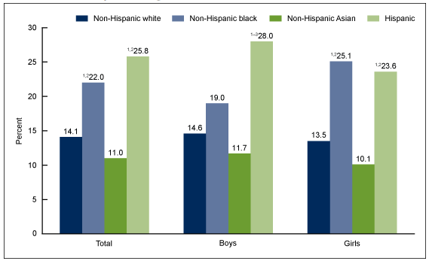
Obesity Prevalence
Prevalence of obesity among youth aged 2–19 years, by sex and race and Hispanic origin: United States, 2015–2016
*Note: Please feel free to update references.
Hales…Ogden et al. JAMA. 2018
Ogden CL, et al. NCHS Data Brief No. 288, October 2017.
Notes:
*Note: Please feel free to update references.

Slide 4
Summary of Evidence & Recent Trends
Childhood obesity is highly prevalent, spares no age group, and is of consequence;
Obesity disproportionately affects racial/ethnic minorities;
Among non-Hispanic white children, obesity prevalence increases as household income and education of head of household decreases – inconsistent association among non-white children;
Progress has been made in obesity reductions among low-income preschool age children;
Not yet closing the gap in disparities with evidence to suggest that the highest risk children have not benefited equally from national obesity prevention efforts.

Slide 5
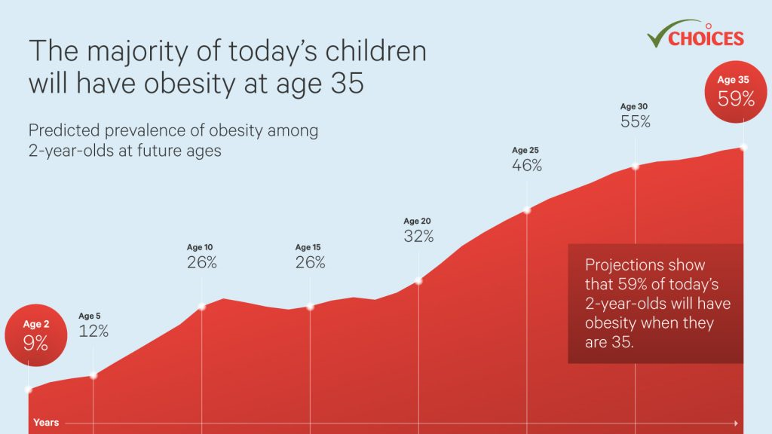
Notes:
*Note: Please feel free to update references.

Slide 6
Role of Pediatric Primary Care
The primary care setting offers unique opportunities to intervene for children at risk for obesity and its complications.
Regular visits during childhood allow both detection of elevated body mass index (BMI) levels and offer opportunities for prevention and treatment.
The continuity of the pediatrician/family relationship, embodied in the concept of the “medical home,” has been associated with increased parental satisfaction, particularly on measures of patient-doctor communication.
Notes:
6

Slide 7
Connect for Health Pediatric Weight Management Program
A proven effective, multilevel intervention
To improve childhood obesity screening, management, and body mass index (BMI)
Clinician and family-facing tools
Now implementing in pediatric primary care practices that serve a diverse patient population
Notes:
7

Slide 8
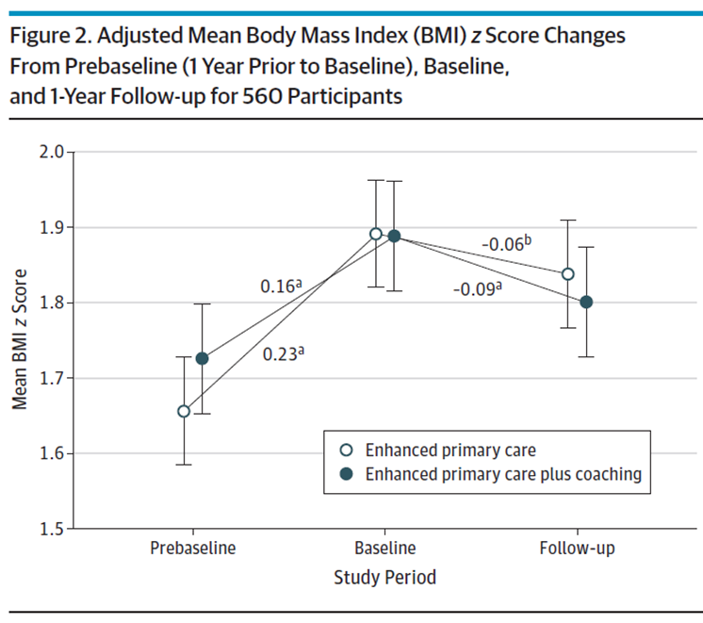
Connect 4 Health
Randomized trial
2-12 year olds + overweight or obesity
6 pediatrics offices in MA
721 children
1 year duration
Intervention Components: Electronic decision support tools; Behavior change materials; Text messaging; Neighborhood resources; Health Coaching
Outcomes: Changes in BMI z-score; child quality of life; behavior change
Taveras et al., JAMA Peds, 2017
Notes:
Childhood obesity affects 1 in 5 children in the US. Most pediatricians find the management of childhood obesity challenging. C4H is a pediatric weight management program that aims to improve screening, management, and body mass index. The program has tools both for pediatric primary care clinicians and families.

Slide 9
Evaluation of Implementation and effectiveness of the Connect for Health across 4 health systems
Research initiative was funded by the Patient-Centered Outcomes Research Institute (PCORI) and the National Institutes of Health (NIH).
Implemented and evaluated in three different states that served diverse patient populations.
Denver Health in Colorado (9 practices)
Prisma Health in South Carolina (7 practices)
Massachusetts General Hospital – Massachusetts (6 practices)
Boston Medical Center – Massachusetts (1 practice)
Clinician and family-facing tools
For families: Text messaging, educational handouts, community resources
For clinicians: EHR best practice alerts, access to education materials for families, and weight management trainings
Adapted and appropriate for telehealth use
Outcomes of C4H
Changes in BMI, family experience of care, implementation outcomes
Simione, M., et al. (2021). Implementation of the Connect for Health pediatric weight management program: study protocol and baseline characteristics. Journal of comparative effectiveness research, 10(11), 881–892. https://www.futuremedicine.com/doi/full/10.2217/cer-2021-0076
Notes:
9

Slide 10
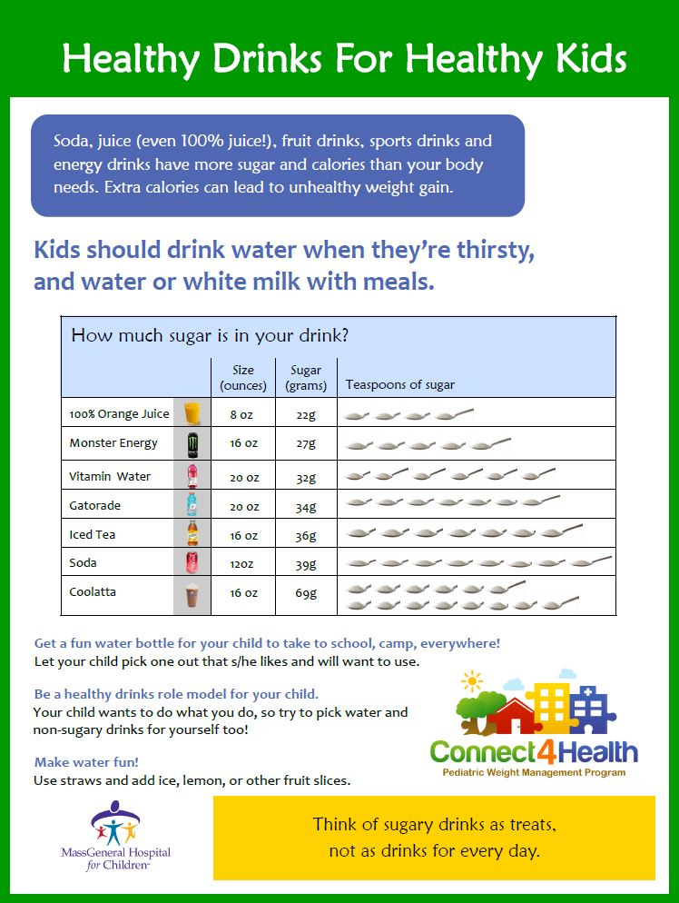
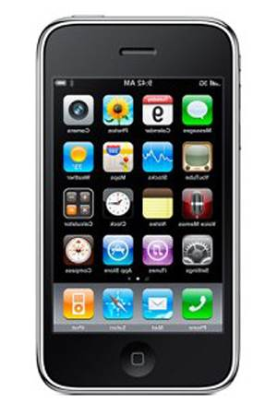
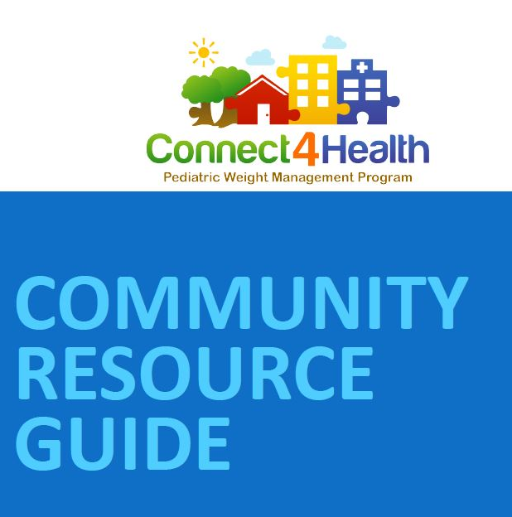
Connect for Health Family Bundle
Family materials
Educational materials to support behavior change self-management;
Text messages;
Connections to resources.
Drink water. Have 0 sugary drinks.
Make sleep a priority. Stick to regular bedtime and wake times for your child.
[Add local resource]
Example:
Boston Natural Areas Network
http://www.bostonnatural.org/
Free guided walks, hikes, rock
climbing, and canoe & bicycle trips
Notes:
*Note: Please feel free to update with site specific resources

Slide 11
Example: Connect for Health Clinician Bundle
Roll out [insert date]
EHR Enhancements [update site specific list]
To be used during well-child office visit
Flagging System for elevated BMI (such as Best Practice Alert- BPA)
Clinical decision support tools to guide screening and management (Smart Set)
Diagnoses, lab orders, structured note template, referrals, after visit summary
Vitals section
Elevated BMIs are highlighted
Clinician/provider training and support
EHR tools were adapted based on clinician feedback
Notes:
SITES – Please customize with your own

Slide 12
Clinician Facing Tools: [insert Flagging System used for Elevated BMI]
*Note: Customizable
[*Note: Please insert site specific screenshot of flagging system such as a “Best Practice Alert (BPA)” that fires based on height and weight, and the child's BMI]

Slide 13
Connect for Health Pediatric Weight Management Orders
Diagnoses
Lab orders
Structured note template
Patient education materials
Text message enrollment
Referrals
Follow-up
After visit summary
*Note: Customize with site specific list of content in the clinical decision support tools
[Insert site specific screenshot of clinical decision support tools such as “Smart Set” that displays the following list]

Slide 14
Questions?
[Insert contact information here]

