Slide 1
Connect for Health Pediatric Weight Management Program Clinician and Staff Training for Launch
[Presenter]
[Date]
*Note: Please use this presentation as a template and feel free to update with site specific information and updated references.
Notes:
Suggested Presenter = Clinician champions or practice coach

Slide 2
Overview
Introductions
Main Points for Discussion
Setting the stage: summary of evidence and trends
Connect for Health randomized controlled trial
Current goals of Connect for Health implementation project
Connect for Health bundle
Family-facing tools
Clinician-facing tools
Questions and Discussion

Slide 3
Introductions
Who I am
Why I got involved
Agenda

Slide 4
Overview
Introductions
Main Points for Discussion
Setting the stage: summary of evidence and trends
Connect for Health randomized controlled trial
Current goals of Connect for Health implementation project
Connect for Health bundle
Family-facing tools
Clinician-facing tools
Questions and Discussion

Slide 5
Setting the Stage: Evidence & Trends
Childhood obesity is highly prevalent, spares no age group, and is of consequence;
Among non-Hispanic white children, obesity prevalence increases as household income and education of head of household decreases – inconsistent association among non-white children;
Progress has been made in obesity reductions among low-income preschool age children;
Not yet closing the gap in disparities with evidence to suggest that the highest risk children have not benefited equally from national obesity prevention efforts.

Slide 6
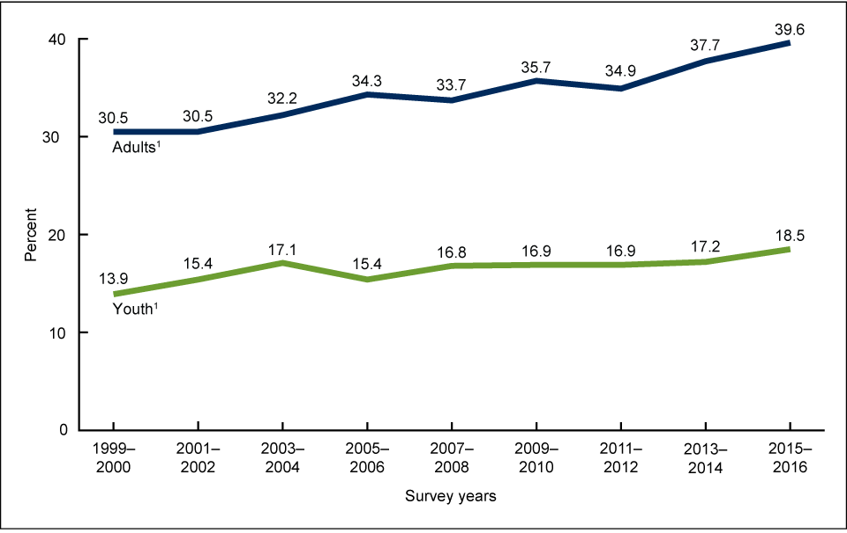
Trends in obesity prevalence among adults and youth: 1999–2016
Obesity Prevalence
*Note: Please feel free to update references.
Ogden CL, et al. NCHS Data Brief No. 288, October 2017.
Notes:
Childhood obesity is highly prevalent, spares no age group, and is of consequence;
*Note: Please feel free to update references.

Slide 7
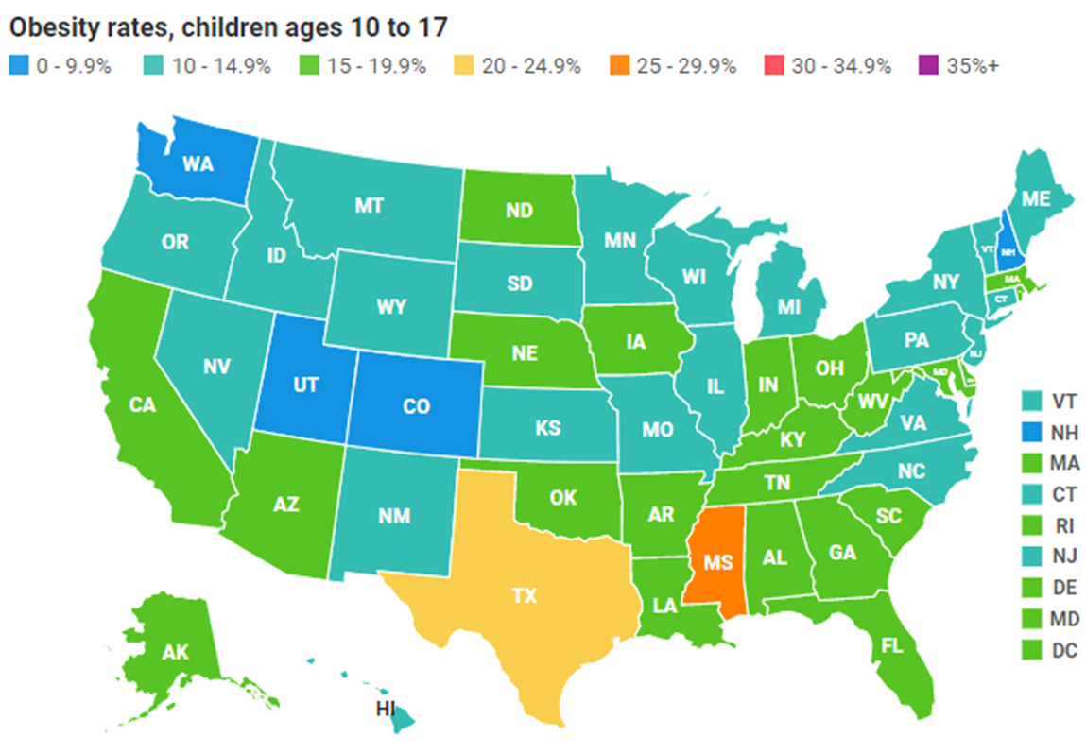
Obesity Prevalence: State-by-State, [Insert Year]
State | Obesity Rate (%)
[add your state]
Ex: Massachusetts | 15.0
RWJF NSCH Data Brief, October 2018.
Notes:
https://media.stateofobesity.org/uploads/2018/10/RWJF_NSCHDataBrief.pdf
https://www.stateofobesity.org/children1017/
*Note: Please update with site specific information and update references.

Slide 8
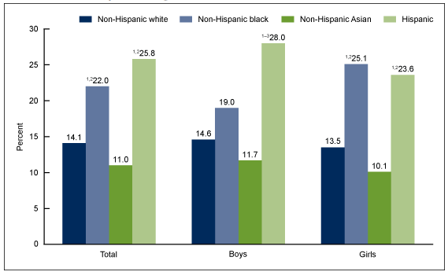
Obesity Disproportionately Affects Minorities
Prevalence of obesity among youth aged 2–19 years, by sex and race and Hispanic origin: United States, 2015–2016
*Note: Please feel free to update references.
Ogden CL, et al. NCHS Data Brief No. 288, October 2017.
Notes:
Obesity disproportionately affects racial/ethnic minorities;
*Note: Please feel free to update references.

Slide 9
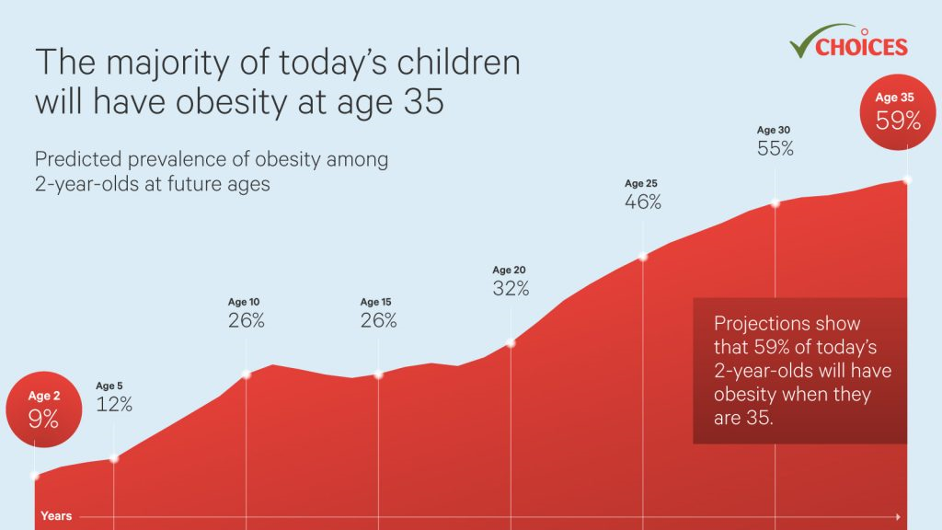
Notes:
*Note: Please feel free to update references.

Slide 10
Role of Pediatric Primary Care
The primary care setting offers unique opportunities to intervene for children at risk for obesity and its complications.
Regular visits during childhood allow both detection of elevated body mass index (BMI) levels and offer opportunities for prevention and treatment.
The continuity of the pediatrician/family relationship, embodied in the concept of the “medical home,” has been associated with increased parental satisfaction, particularly on measures of patient-doctor communication.
Notes:
10

Slide 11
What is the role of the Primary Care Physician?
Screen for elevated body mass index (BMI)
Use evidence based guidelines for management
Laboratory evaluation as needed
Provide counseling (nutrition/activity/sleep/social-emotional wellness)
Refer for treatment
Make a plan for follow-up
This project aims to help with these guidelines

Slide 12
Overview
Introductions
Main Points for Discussion
Setting the Stage: Summary of Evidence and Trends
Connect for Health randomized controlled trial
Current goals of Connect for Health implementation project
Connect for Health bundle
Family-facing tools
Clinician-facing tools
Questions and Discussion

Slide 13
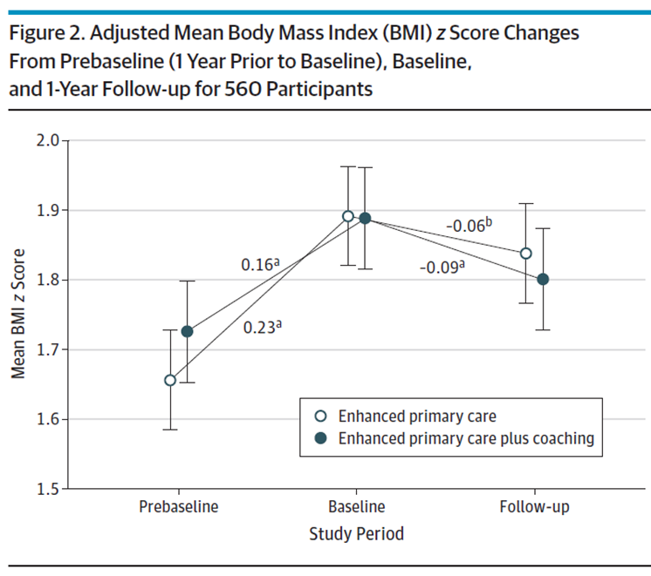
Connect for Health
Randomized trial
2-12 year-olds with overweight or obesity
6 pediatric offices in MA
721 children
1 year duration
Intervention Components: Electronic decision support; Behavior change materials; Text messaging; Neighborhood resources; Health Coaching
Outcomes: Changes in BMI z-score Child quality of life Behavioral change
Decrease in BMI
Taveras et al., 2017, JAMA Peds
Notes:
C4H is based on a randomized control trial funded by PCORI. It was a year long trial that included 2-12 year olds. One group received enhanced primary care including clinical decision support tools, educational materials, neighborhood resources for families, and a text messaging program. The other group in the trial had this plus health coaching as well. At the end of the trial, both groups showed changes in BMI and family-centered outcomes.

Slide 14
Evaluation of Implementation and effectiveness of the Connect for Health across 4 health systems
Research initiative was funded by the Patient-Centered Outcomes Research Institute (PCORI) and the National Institutes of Health (NIH).
Implemented and evaluated in three different states that served diverse patient populations.
Denver Health in Colorado (9 practices)
Prisma Health in South Carolina (7 practices)
Massachusetts General Hospital – Massachusetts (6 practices)
Boston Medical Center – Massachusetts (1 practice)
Clinician and family-facing tools
For families: Text messaging, educational handouts, community resources
For clinicians: EHR best practice alerts, access to education materials for families, and weight management trainings
Adapted and appropriate for telehealth use
Outcomes of C4H
Changes in BMI, family experience of care, implementation outcomes
Simione et al., 2021, J. Comp. Eff. Res.
Notes:
Reference:
Simione, M., et al. (2021). Implementation of the Connect for Health pediatric weight management program: study protocol and baseline characteristics. Journal of Comparative Effectiveness Research, 10(11), 881–892. https://www.futuremedicine.com/doi/full/10.2217/cer-2021-0076

Slide 15
We have optimized and adapted the Connect for Health at our site
Thinking about sustainability from day one
If successful, program is here to stay
Customizing the program
Electronic health record (EHR) tools
Patient educational materials and text messaging program
Clinician training
Community based resources
*Note: Add examples of how you have customized at your site
Notes:
Based on our findings, we have then adapted the program components. [Can insert any site-specific examples]

Slide 16
Example of how optimizing and adapting Connect for Health: Feedback
Clinician interviews & parent surveys
Assessed needs, perspectives, preferences, and barriers and facilitators to program uptake
Feedback we heard
Clinicians wanted resources to address pediatric weight management and preferred tools that were culturally appropriate and enhanced patient care without disrupting workflow
“This is an area that is very frustrating for me because I feel that we don’t have adequate support for caring for these patients”
“Things that are relevant in a variety of different cultural contexts like Hispanic families or families from Asian or Indian backgrounds. Broadening the examples of foods that I give would also help.”
“Some of our Best Practice Alerts - the ones that are part of the screen so you can see they’re there, but they’re not obtrusive and they allow you to act on them at any time. I think those are helpful potentially.”
*Note: optional slide, update with feedback you heard at your site
Notes:
This slide is animated

Slide 17
Optimizing and Adapting Connect for Health: Parent Surveys
How important is it to you that your child's provider talk about a plan to help your child get to a healthy weight?
93% stated “extremely important” or “very important”
How helpful do you think text messages with tips about making behavior changes would be?
74% stated “very helpful”;
22% “somewhat helpful”
Preferred method for sending messages with tips about behavior changes:
1. Text messaging 2. Email
How important is it to you that your child's provider gives you a plan to help your child get to a healthy weight?
91% stated “extremely important” or “very important”
*Note: optional slide, update with feedback you heard at your site
Three most preferred ways of receiving educational handouts:
1. Printed 2. Texted 3. Emailed
Notes:
*Note: optional slide, update with feedback you heard at your site

Slide 18
What matters to parents and families?
De-emphasize weight/BMI goal; focus instead on outcomes of interest to parents and children:
Child doing well in school → decrease screen time and read more
Fit into size 12 clothing to be able to avoid plus-size store → cut out sugary drinks
Organized, functional household → Keep routines, schedules, plan ahead
Good behavior, attention → get more sleep, earlier to bed
Empower parents to be the “policy-makers” and leaders in their own homes;
They create (and enforce) “house” rules on screen time, bedtime, homework, physical activity, snacking, caffeinated beverages, and eating in front of TVs.

Slide 19
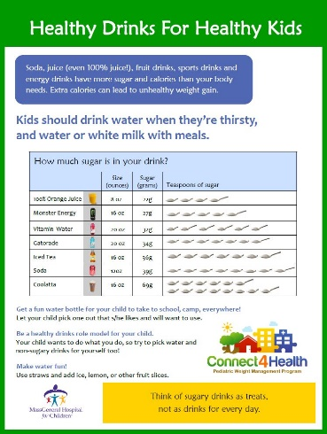
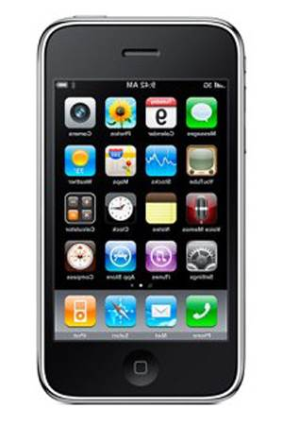
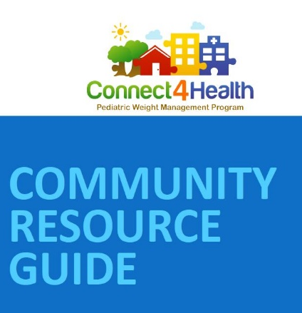
Connect for Health Bundle for families
Family materials
Educational materials to support behavior change self-management;
Text messages;
Connections to resources.
Available in English & Spanish.
Drink water. Have 0 sugary drinks.
Make sleep a priority. Stick to regular bedtime and wake times for your child.
[Add local resource]
Website link
Small description
*Note: Please feel free to update with site specific resource
Notes:
*Note: Please feel free to update with site specific resources

Slide 20
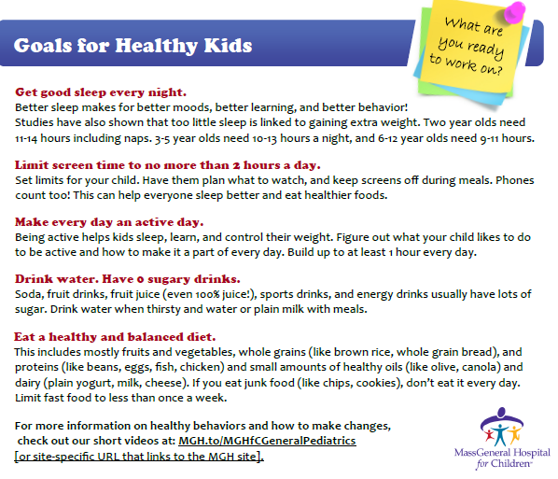
Educational Materials—Behavioral Topics
Sleep
Screen Time
Physical Activity
Sugar Sweetened Beverages
Nutrition
Social and Emotional Wellness

Slide 21
Text Messaging
How much sleep do children need? 2 year-olds need 11-14 hours including naps. 3-5 year-olds need 10-13 hours a night, and 6-12 year-olds need 9-11 hours.
1-2 scheduled messages sent per week for one year
Self-monitoring messages to help parents track child’s health-related behaviors
Skills training messages that delivered tips and encouraged families to work towards the targeted goal for each behavior
Messages that connect families to resources
Check out ChopChop Magazine for children online and get your children helping in the kitchen. Healthy cooking ideas and lots of fun!
www.chopchopfamily.org

Slide 22
Neighborhood Resource Guide
Insert Resource Name Here
Description
Days and Hours
Address
Website Link
Insert Resource Name Here
Description
Days and Hours
Address
Website Link
Notes:
Please customize resource examples to your area!

Slide 23
Our Approach
Connect for Health takes a positive approach to health and proposes a whole-family, healthy lifestyle plan with recommendations for sleep, healthy drinks, physical activity, healthy foods and screen time. We advocate for family change, and our recommendation to parents is to lead by example and teach children healthy habits now that will benefit them for their whole lives. In addition, we help families connect to resources in their communities that can support their healthy behavior changes.

Slide 24
How is Connect for Health different from other programs for children?
Connect for Health uses a whole family approach – not targeted directly to children
Connect for Health focuses on adopting healthy habits – not about counting calories or watching the scale
Connect for Health does not talk about weight loss; it is focused on weight management and maintenance
Connect for Health is not just about WHAT children eat; it is about focusing on an eating plan that includes how, where, and when we eat

Slide 25
Overview
Introductions
Main Points for Discussion
Setting the stage: summary of evidence and trends
Connect for Health randomized controlled trial
Current goals of Connect for Health implementation project
Connect for Health bundle
Family-facing tools
Clinician-facing tools
Questions and Discussion

Slide 26
Connect for Health Bundle for clinicians
Flagging of children with body mass index (BMI) ≥ 85th/ 95th percentile;
Clinician decision support tools to guide screening and management;
Clinician training and support.

Slide 27
Flagging System for Elevated BMI
[*Note: Please insert site specific screenshot of flagging system such as a “Best Practice Alert (BPA)” that fires based on height and weight, and the child's BMI]
Notes:
SITES – Please customize with your own EHR screenshots

Slide 28
Clinical Decision Support Tools
Diagnoses
Lab orders
Structured note template
Patient education materials
Text message enrollment
Referrals
Follow-up
After visit summary
*Note: Customize with site specific list of content in the clinical decision support tools
[Insert site specific screenshot of clinical decision support tools such as “Smart Set” that displays the following list]
Notes:
SITES – Please customize with your own EHR screenshots

Slide 29
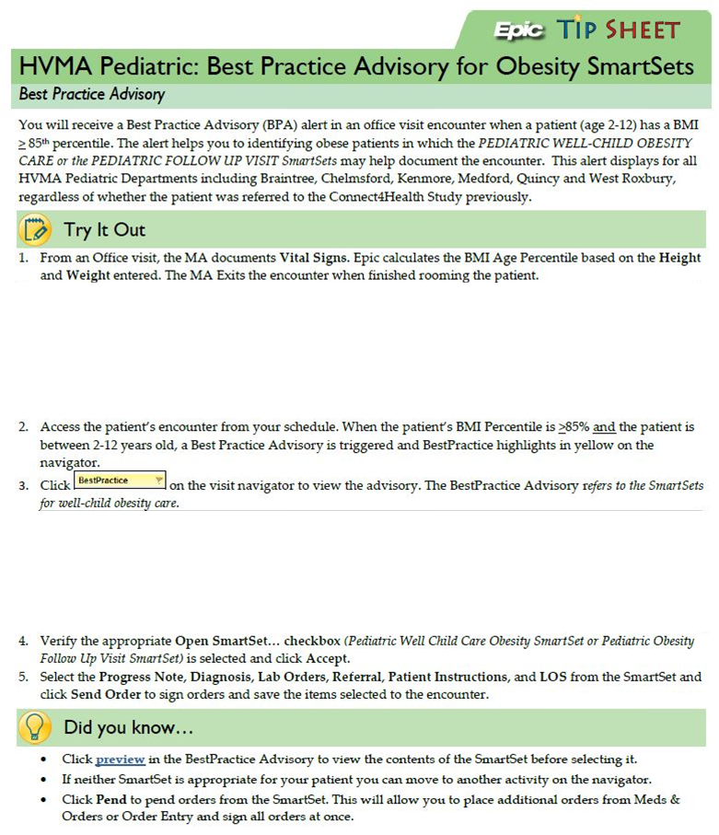
EHR Tip Sheet
*Note: Please insert site specific Electronic Health Record (EHR) screenshot of tip sheet that highlights on how to use Connect for Health flagging system and clinical decision support tools and their location in your EHR system
[Please insert site specific screenshot of vitals that capture height and weight, and the child's BMI]
[Please insert site specific screenshot of flagging system such as a “Best Practice Alert (BPA)” that shows clinical decision tools options]
Notes:
SITES – Please customize with your own tip sheet

Slide 30
Clinician Training and Support
Electronic health record (EHR) screening and clinical decision support tools
Clinician champions and practice coaches for “at the elbow support”
In-person trainings and check-ins
Tutorials, manuals, EHR Tip Sheets
Learning community
Website http://c4hprogram.com/
Strategies to support integration into practice
Strategies to increase knowledge

Slide 31
Timeline
Notes:
SITES – Please customize roll-out across the site

Slide 32
Overview
Introductions
Main Points for Discussion
Setting the Stage: Summary of Evidence and Trends
Connect for Health randomized controlled trial
Current goals of Connect for Health implementation project
Connect for Health bundle
Family-facing tools
Clinician-facing tools
Questions and Discussion

Slide 33
Questions and Discussion
Thank you!

